Slide 1

Red Black SOR Solver
Aditya Ujeniya
16th OCTOBER 2023
With acknowledgements to Jan Eitzinger

Slide 2
Objectives
Basics about 2D Poisson Solver and its discretization
Red Black SOR solver
Lexicographic ordering vs Red Black SOR ordering
Basic Pseudocode for Red Black SOR
Enhanced Pseudocode for Red Black without if condition
LIKWID perfctr comparison between Normal SOR and Red Black SOR
Performance comparison and Speedup
Convergence test and results

Slide 3
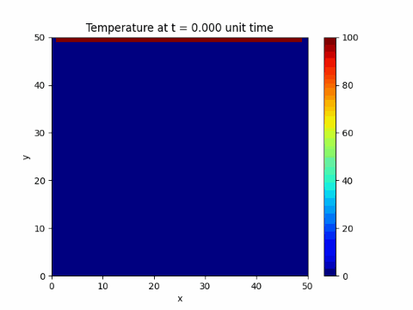
2D Poisson Solver for Heat Equation
Ref : https://levelup.gitconnected.com/solving-2d-heat-equation-numerically-using-python-3334004aa01a

Slide 4
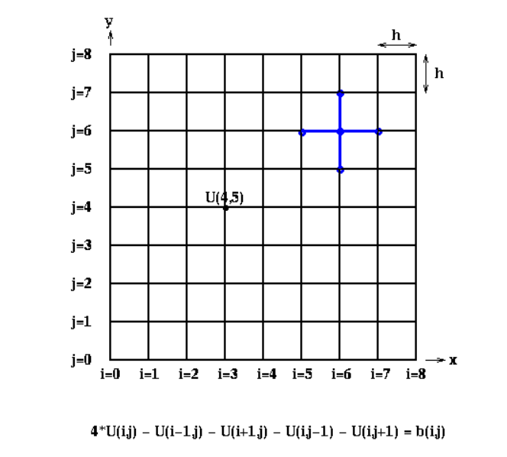
Discretization of 2D Poisson Heat Equation
Ref : https://people.eecs.berkeley.edu/~demmel/cs267/lecture24/lecture24.html

Slide 5
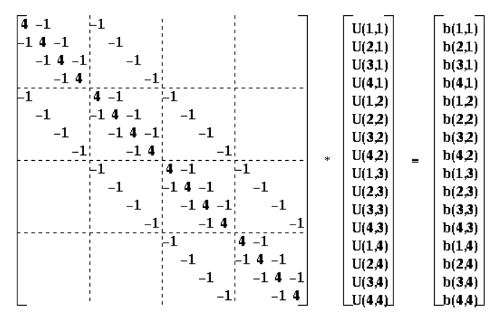
Discrete Poisson Problem on 4x4 Grid
Ref : https://people.eecs.berkeley.edu/~demmel/cs267/lecture24/lecture24.html

Slide 6
Iterative Solver - Jacobi
for i=1 to n
for j=1 to n
U(i, j, m+1) = ( U(i-1, j, m) + U(i+1, j, m) +
U(i, j-1, m) + U(i, j+1, m) + b(i, j) )/4
end for
end for
Ref : https://people.eecs.berkeley.edu/~demmel/cs267/lecture24/lecture24.html

Slide 7
Iterative Solver – Gauss Seidel
for i=1 to n
for j=1 to n
U(i, j, m+1) = ( U(i-1, j, m+1) + U(i+1, j, m) +
U(i, j-1, m+1) + U(i, j+1, m) + b(i, j) )/4
end for
end for
Ref : https://people.eecs.berkeley.edu/~demmel/cs267/lecture24/lecture24.html

Slide 8
Iterative Solver – Gauss Seidel SOR
for i=1 to n
for j=1 to n
U(i, j, m+1) = U(i, j, m) + w * ( U(i-1, j, m+1) + U(i+1, j, m) + U(i, j-1, m+1) + U(i, j+1, m) + b(i, j)
- 4 * U(i, j, m) )/4
end for
end for
w > 1 : Overrelaxation
w < 1 : Underrelaxation
Usually, 1 < w 2
Ref : https://people.eecs.berkeley.edu/~demmel/cs267/lecture24/lecture24.html

Slide 9
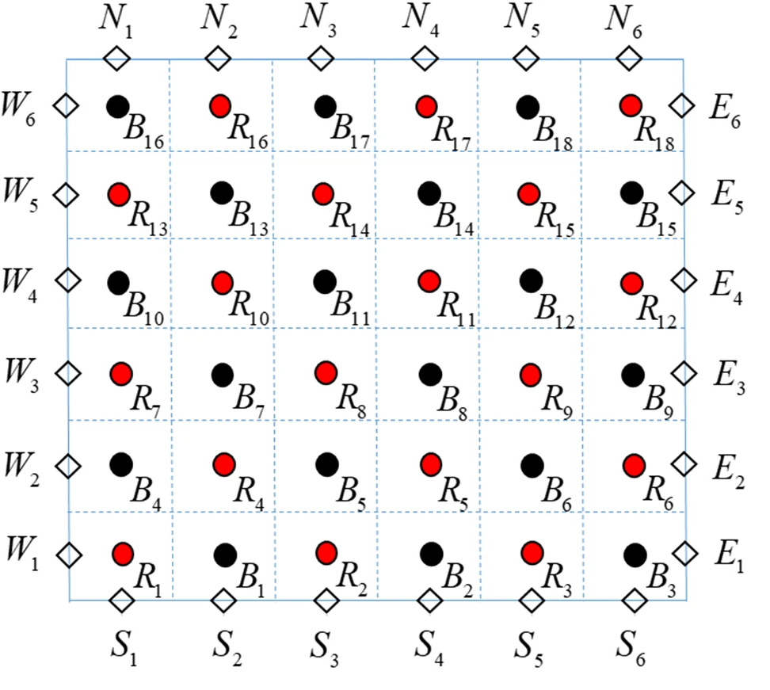
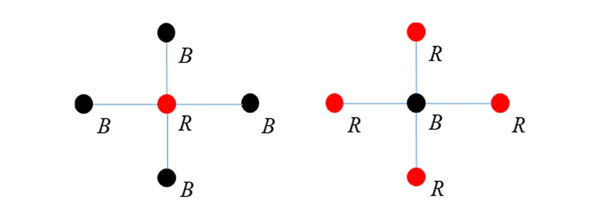
Red-Black SOR Solver
This process splits every iteration into red and black half iterations.
Each half iteration is independent from the other half.
Ref : https://link.springer.com/article/10.1007/s11227-020-03221-1/figures/1

Slide 10
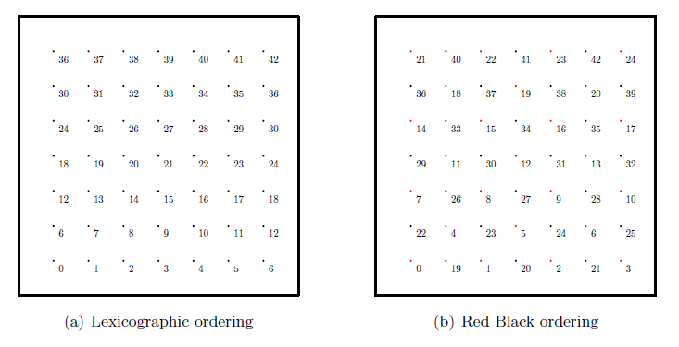
Ordering of RB vs Normal Solver
Ref : https://www10.cs.fau.de/publications/dissertations/Diss_2009-Treibig.pdf

Slide 11
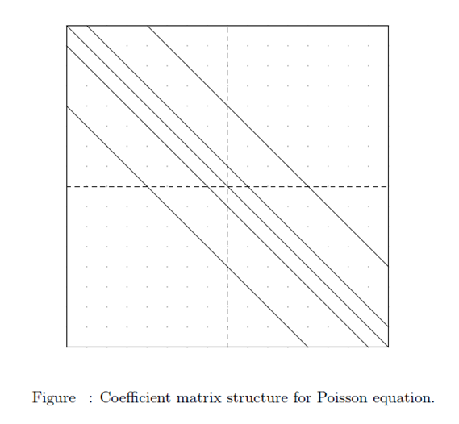
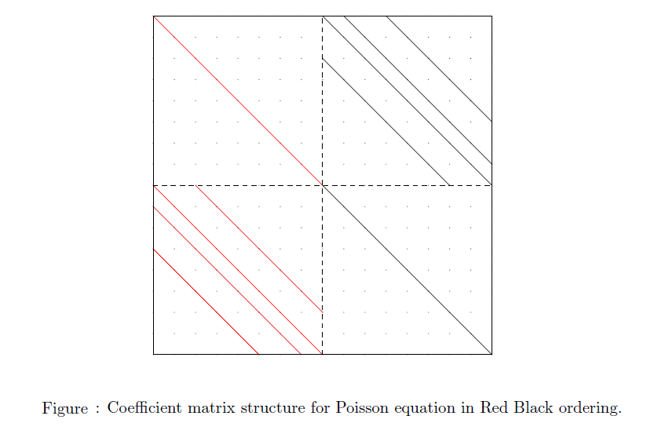
Coefficient Matrix of RB vs Normal Solver
Ref : https://www10.cs.fau.de/publications/dissertations/Diss_2009-Treibig.pdf

Slide 12
Basic Algorithm for RB
#run for the desired number of iterations
repeat number of iterations times
# red half iteration
for(i=1 ; i < n-1 ; ++i) {
for(j=1 ; j < m-1 ; ++j) {
if ( (i+j) mod 2 == 0) {
U[i,j]=( U[i-1,j] + U[i+1,j] + U[i,j-1] + U[i;j+1] + b[i,j] )/4.0
}
}
}
# black half iteration
for(i=1 ; i < n-1 ; ++i) {
for(j=1 ; j < m-1 ; ++j) {
if ( (i+j) mod 2 == 1) {
U[i,j]=( U[i-1,j] + U[i+1,j] + U[i,j-1] + U[i,j+1] + b[i,j] )/4.0
}
}
}
end repeat

Slide 13
Algorithm without if condition in RB
#run for the desired number of iterations
repeat number of iterations times
isw = 1;
for (pass = 0; pass < 2; pass++)
{
jsw = isw;
# red half iteration if isw = 1 and black half iteration if isw = 2
for(i=1 ; i < n-1 ; ++i)
{
for(j=jsw ; j < m-1 ; ++j)
{
U[i,j]=( U[i-1,j] + U[i+1,j] + U[i,j-1] + U[i,j+1] + b[i,j] )/4.0
}
jsw = 3 - jsw;
}
isw = 3 - isw;
}
end repeat
Ref : https://www.cec.uchile.cl/cinetica/pcordero/MC_libros/NumericalRecipesinC.pdf

Slide 14
Runtime comparison between Normal and RB SOR

Slide 15
Speedup scaling for RB SOR

Slide 16
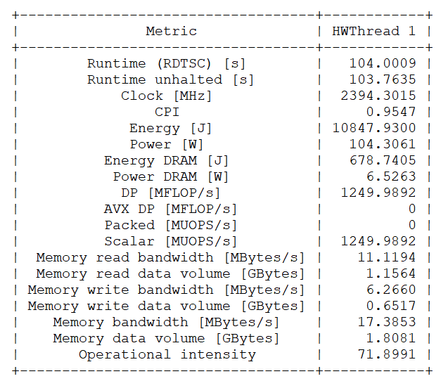
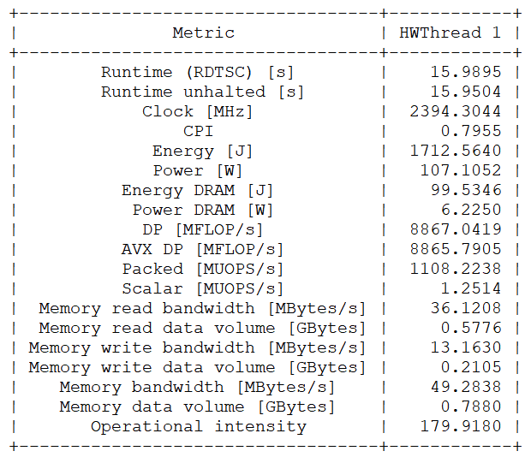
LIKWID counter comparison
1000x1000 Mesh size with 10000 iterations
Normal SOR
RB SOR
-O3 -xHost -qopt-zmm-usage=high

Slide 17
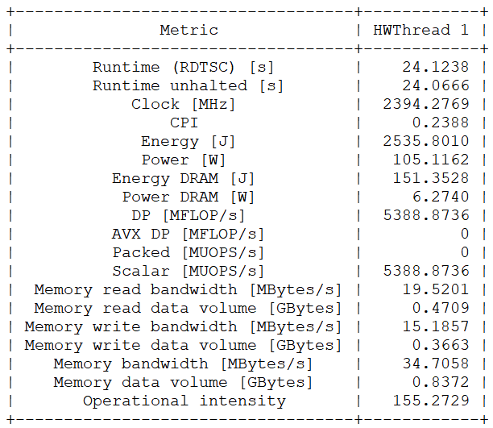
LIKWID counter comparison
1000x1000 Mesh size with 10000 iterations
Normal SOR
RB SOR
-O3 -xHost –fp-model=precise -qopt-zmm-usage=high

Slide 18
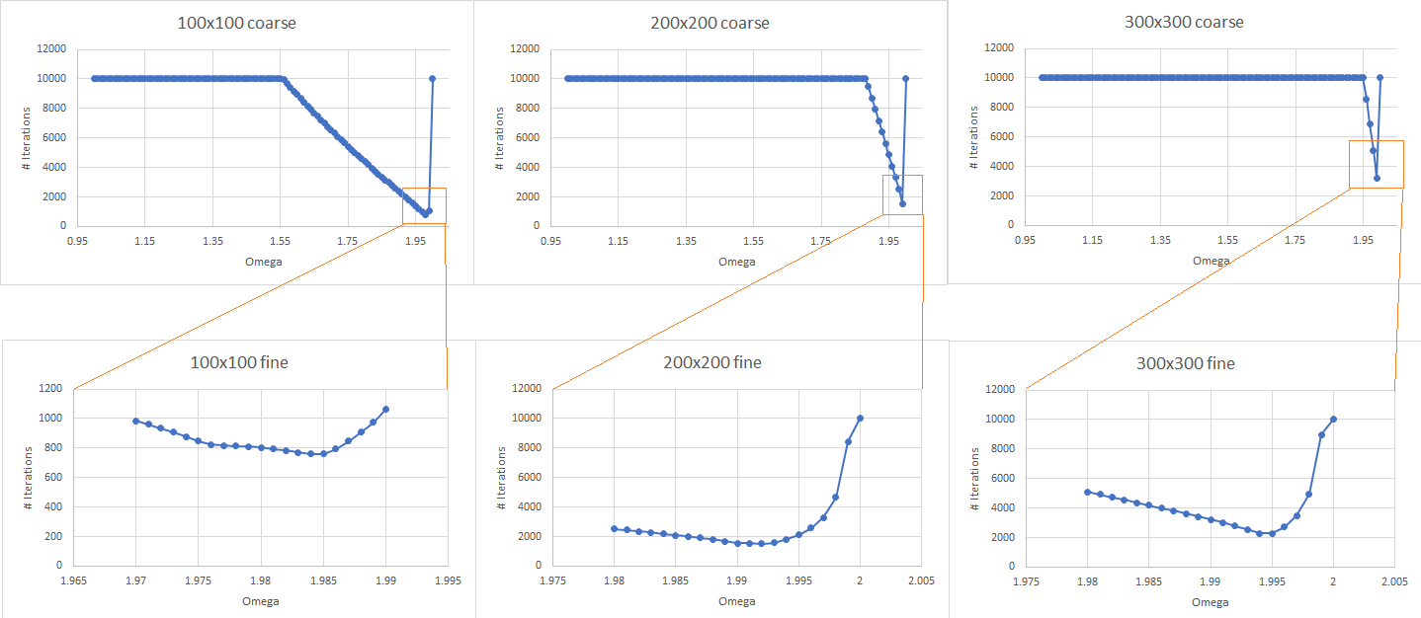
Convergence test and results on 2D Poisson solver

