Slide 1

Particle Tracing
Aditya Ujeniya
16th OCTOBER 2023
With acknowledgements to Jan Eitzinger

Slide 2
Objectives
Basics about Particle Tracing
How to interpolate in 2D
Results from 2D sequential code
Basic idea for 2D MPI
Future work

Slide 3
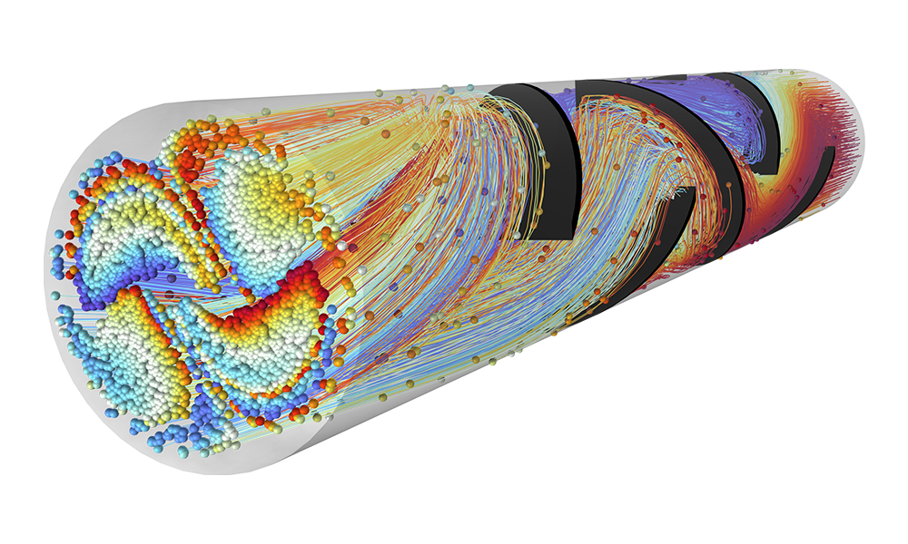
What is Particle Tracing
Ref : https://cdn.comsol.com/product-new/particle-tracing-module/full/particle-tracing-module-hero.png

Slide 4
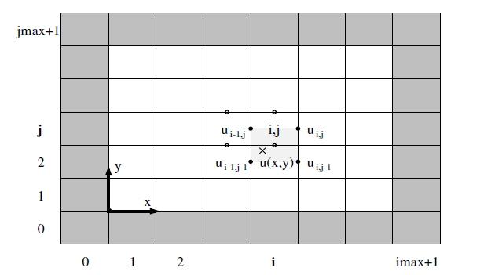

Interpolating using nearest discrete velocity fields
What do we have ?
  x, y positions.
  U and V velocity fields.
What do we need ?
  u(x, y) and v(x, y) to get u and v velocity at x and y.
Compute new x and y using Euler method:
Ref : https://epubs.siam.org/doi/book/10.1137/1.9780898719703

Slide 5
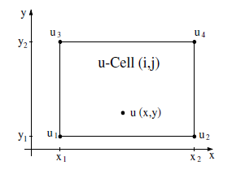
Interpolating using nearest discrete velocity fields
Bilinear Interpolation:
Ref : https://epubs.siam.org/doi/book/10.1137/1.9780898719703

Slide 6
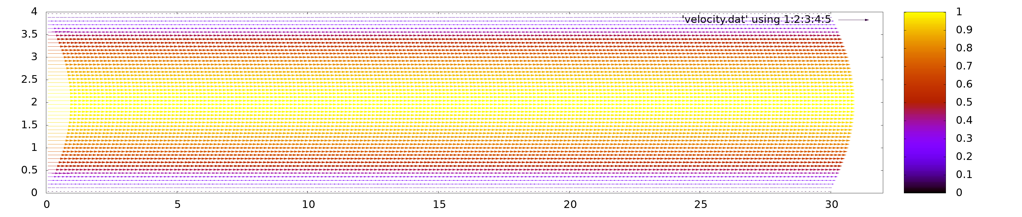

Results - canal

Slide 7
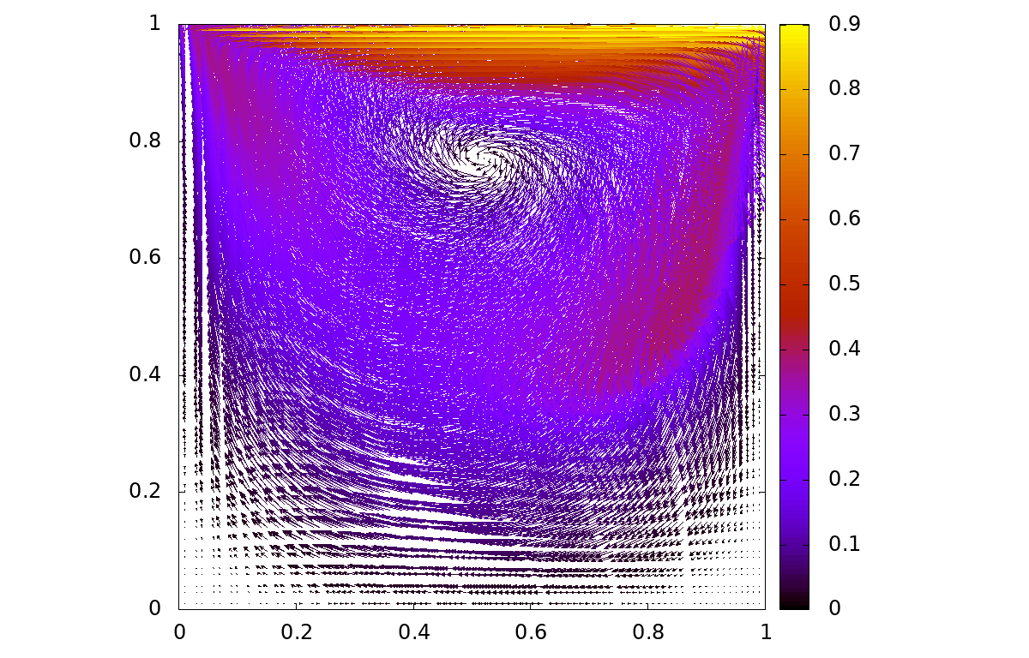
Results - dcavity

Slide 8
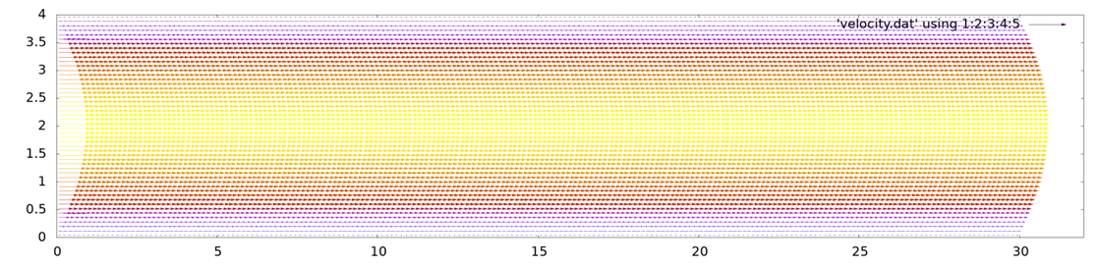
MPI-Implementation
jmaxLocal
Rank 1
jmaxLocal
Rank 3
jmaxLocal
Rank 5
jmaxLocal
Rank 7
imaxLocal
imaxLocal
imaxLocal
imaxLocal
jmaxLocal
Rank 0
jmaxLocal
Rank 2
jmaxLocal
Rank 4
jmaxLocal
Rank 6
imaxLocal
imaxLocal
imaxLocal
imaxLocal

Slide 9
MPI-Implementation
Share xStart, xEnd, yStart & yEnd with each other using MPI_GatherAll()
If particle leaves domain, check in this table to which rank to send.
Communicate number of particles to be sent to other ranks.
If particle leaves domain and belongs to no rank, turn off the particle.
xStart | yStart | xEnd | yEnd
Rank 0
Rank 1
Rank 2
.
.
.

Slide 10
Future Work
Use MPI I/O for writing to the same file rather than sending particles from all ranks to rank 0 and let rank 0 write the particles to single file.

