Slide 1

Enhanced Solver
Aditya Ujeniya
16th OCTOBER 2023
With acknowledgements to Jan Eitzinger

Slide 2
Objectives
What is Enhanced Solver
How Enhanced Solver works
Results – Backward Facing Step
Results – Karman Street Vortexes

Slide 3
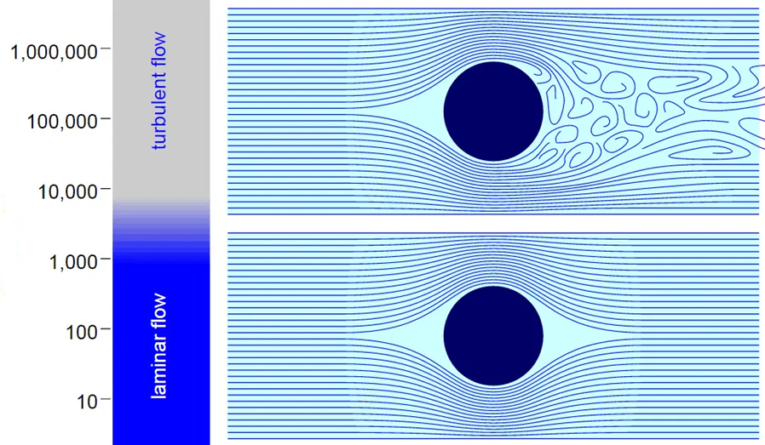
Enhanced Solver
Re

Slide 4
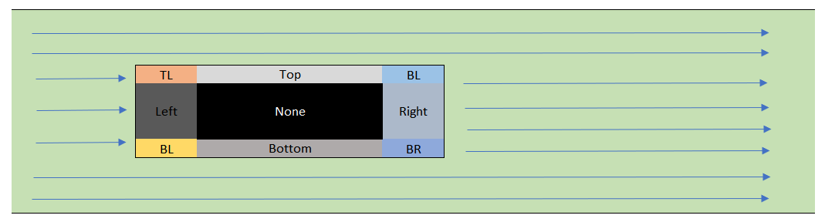
How it works
Determing the shape and assign boundary indexes in the matrix.
Then handle the NO SLIP boundary condition for different boundary index.
We have tried with CIRCLE and RECTANGLE/SQUARE.

Slide 5
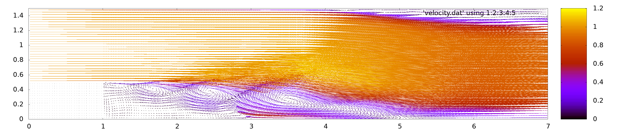
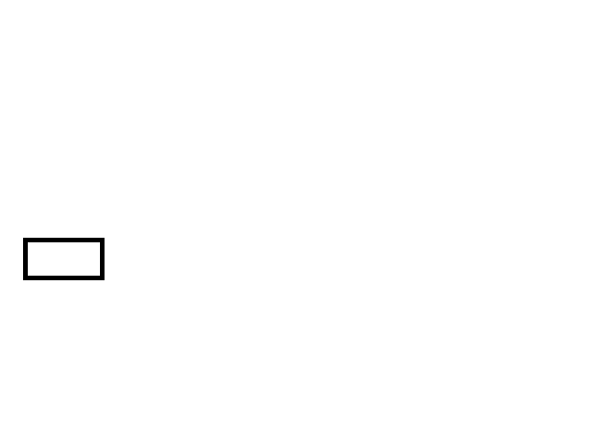
Results – Backward Facing Step with Eddy currents
Re : 5000

Slide 6
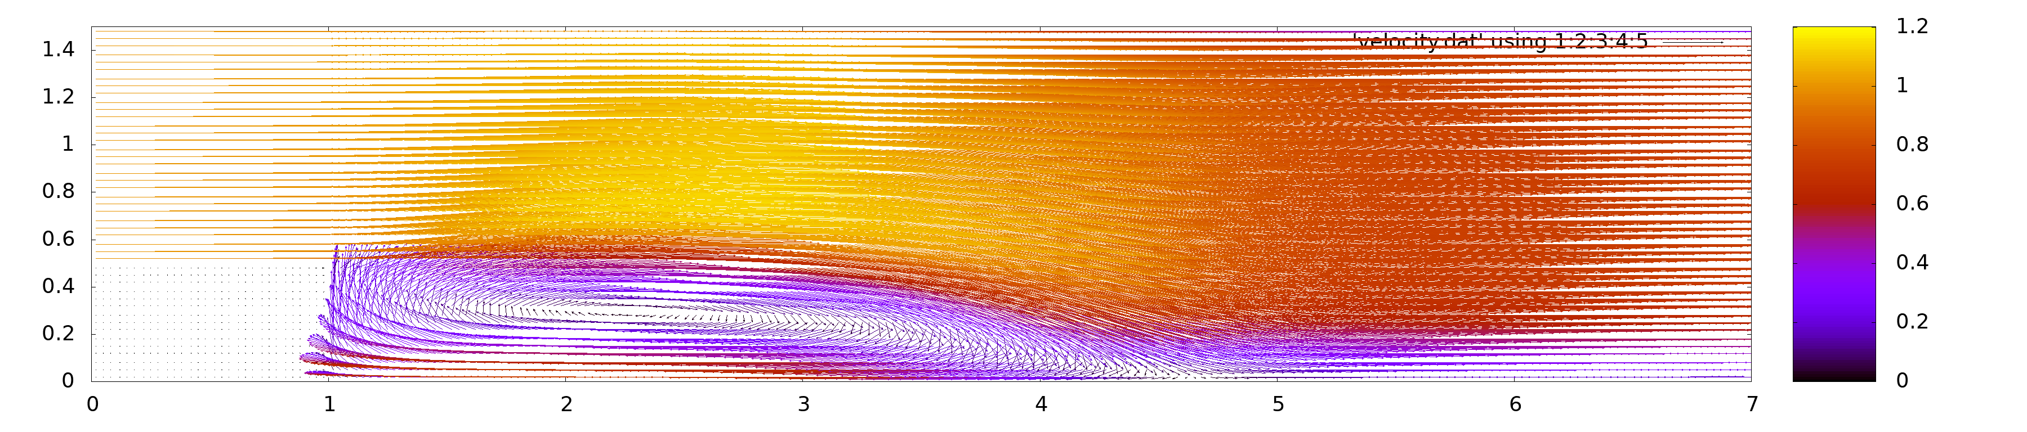
Results – Backward Facing Step with Recirculation zone
Re : 36000

Slide 7
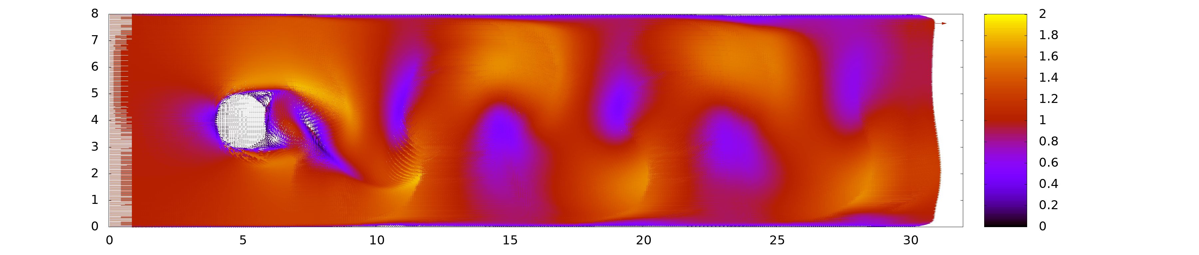

Results – Karman Vortex Street
Re : 5000

