Slide 1

Red Black SOR Solver
Aditya Ujeniya
16th OCTOBER 2023
With acknowledgements to Jan Eitzinger

Slide 2
Objectives
Basics about 2D Poisson Solver and its discretization
Red Black SOR solver
Lexicographic ordering vs Red Black SOR ordering
Basic Pseudocode for Red Black SOR
Enhanced Pseudocode for Red Black without if condition
LIKWID perfctr comparison between Normal SOR and Red Black SOR
Performance comparison and Speedup
Convergence test and results

Slide 3
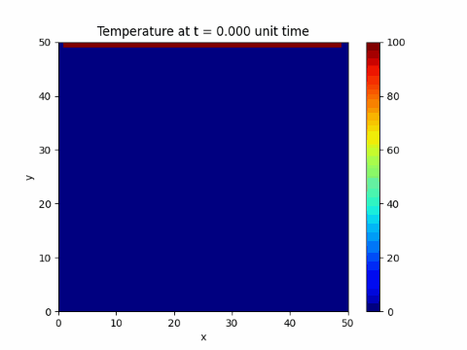
2D Poisson Solver for Heat Equation
Ref : https://levelup.gitconnected.com/solving-2d-heat-equation-numerically-using-python-3334004aa01a

Slide 4
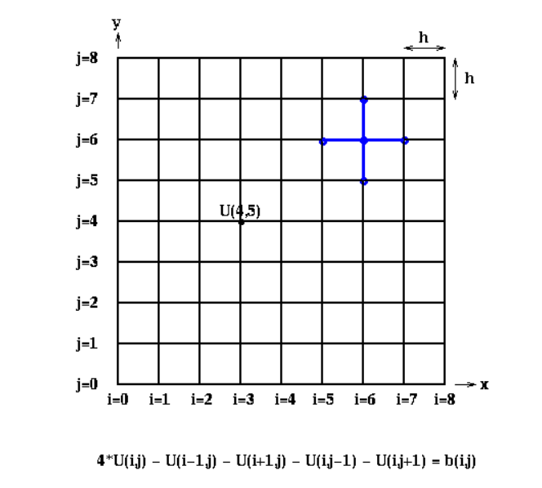
Discretization of 2D Poisson Heat Equation
Ref : https://people.eecs.berkeley.edu/~demmel/cs267/lecture24/lecture24.html

Slide 5
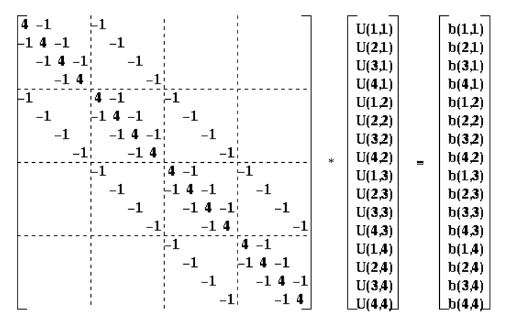
Discrete Poisson Problem on 4x4 Grid
Ref : https://people.eecs.berkeley.edu/~demmel/cs267/lecture24/lecture24.html

Slide 6
Iterative Solver - Jacobi
for i=1 to n
for j=1 to n
U(i, j, m+1) = ( U(i-1, j, m) + U(i+1, j, m) +
U(i, j-1, m) + U(i, j+1, m) + b(i, j) )/4
end for
end for
Ref : https://people.eecs.berkeley.edu/~demmel/cs267/lecture24/lecture24.html

Slide 7
Iterative Solver – Gauss Seidel
for i=1 to n
for j=1 to n
U(i, j, m+1) = ( U(i-1, j, m+1) + U(i+1, j, m) +
U(i, j-1, m+1) + U(i, j+1, m) + b(i, j) )/4
end for
end for
Ref : https://people.eecs.berkeley.edu/~demmel/cs267/lecture24/lecture24.html

Slide 8
Iterative Solver – Gauss Seidel SOR
for i=1 to n
for j=1 to n
U(i, j, m+1) = U(i, j, m) + w * ( U(i-1, j, m+1) + U(i+1, j, m) + U(i, j-1, m+1) + U(i, j+1, m) + b(i, j)
- 4 * U(i, j, m) )/4
end for
end for
w > 1 : Overrelaxation
w < 1 : Underrelaxation
Usually, 1 < w 2
Ref : https://people.eecs.berkeley.edu/~demmel/cs267/lecture24/lecture24.html

Slide 9
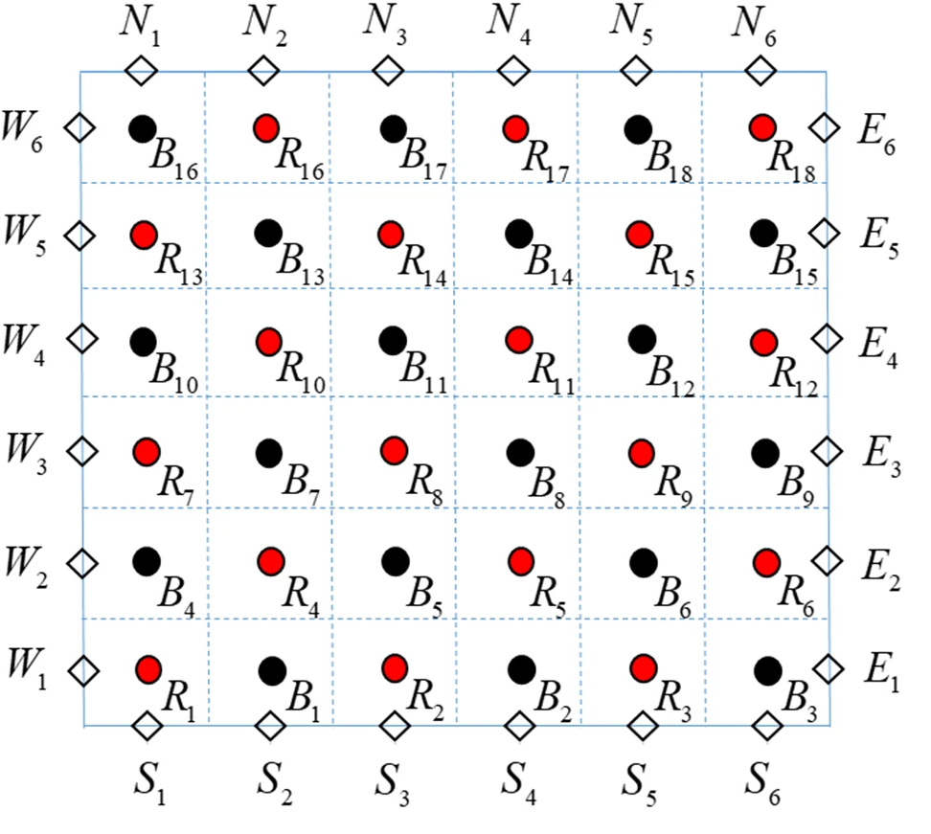
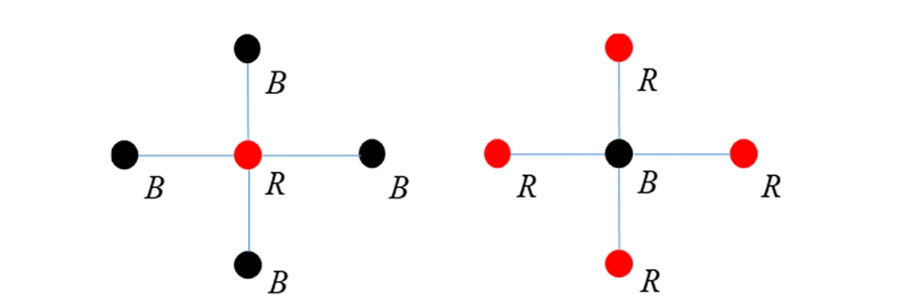
Red-Black SOR Solver
This process splits every iteration into red and black half iterations.
Each half iteration is independent from the other half.
Ref : https://link.springer.com/article/10.1007/s11227-020-03221-1/figures/1

Slide 10
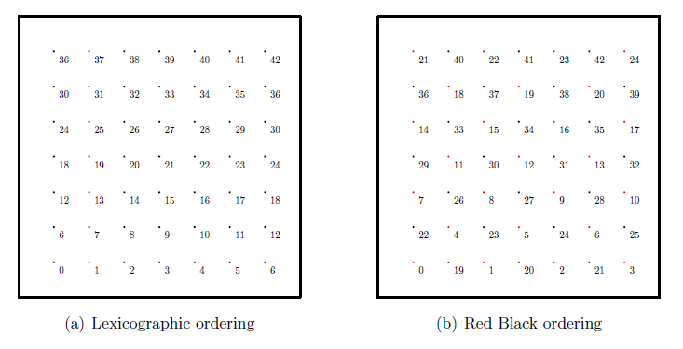
Ordering of RB vs Normal Solver
Ref : https://www10.cs.fau.de/publications/dissertations/Diss_2009-Treibig.pdf

Slide 11
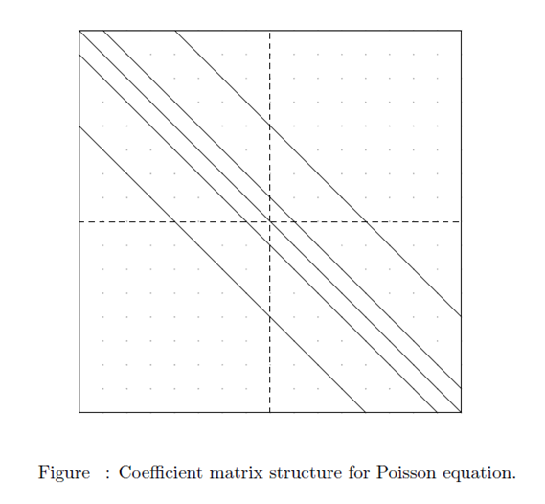
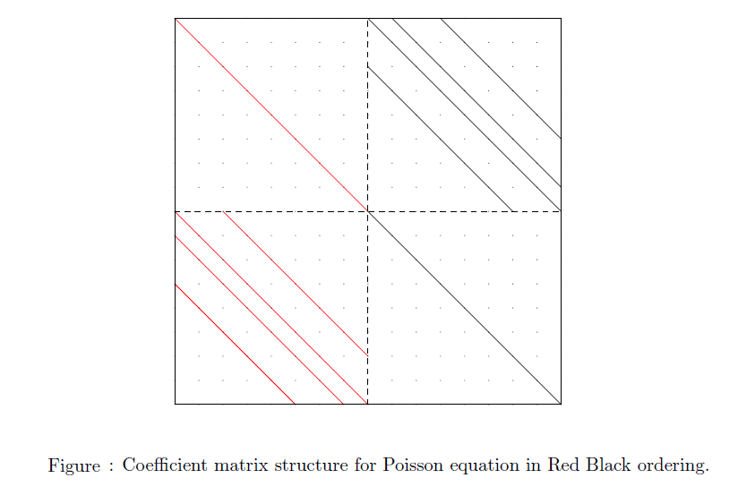
Coefficient Matrix of RB vs Normal Solver
Ref : https://www10.cs.fau.de/publications/dissertations/Diss_2009-Treibig.pdf

Slide 12
Basic Algorithm for RB
#run for the desired number of iterations
repeat number of iterations times
# red half iteration
for(i=1 ; i < n-1 ; ++i) {
for(j=1 ; j < m-1 ; ++j) {
if ( (i+j) mod 2 == 0) {
U[i,j]=( U[i-1,j] + U[i+1,j] + U[i,j-1] + U[i;j+1] + b[i,j] )/4.0
}
}
}
# black half iteration
for(i=1 ; i < n-1 ; ++i) {
for(j=1 ; j < m-1 ; ++j) {
if ( (i+j) mod 2 == 1) {
U[i,j]=( U[i-1,j] + U[i+1,j] + U[i,j-1] + U[i,j+1] + b[i,j] )/4.0
}
}
}
end repeat

Slide 13
Algorithm without if condition in RB
#run for the desired number of iterations
repeat number of iterations times
isw = 1;
for (pass = 0; pass < 2; pass++)
{
jsw = isw;
# red half iteration if isw = 1 and black half iteration if isw = 2
for(i=1 ; i < n-1 ; ++i)
{
for(j=jsw ; j < m-1 ; ++j)
{
U[i,j]=( U[i-1,j] + U[i+1,j] + U[i,j-1] + U[i,j+1] + b[i,j] )/4.0
}
jsw = 3 - jsw;
}
isw = 3 - isw;
}
end repeat
Ref : https://www.cec.uchile.cl/cinetica/pcordero/MC_libros/NumericalRecipesinC.pdf

Slide 14
Runtime comparison between Normal and RB SOR

Slide 15
Speedup scaling for RB SOR

Slide 16
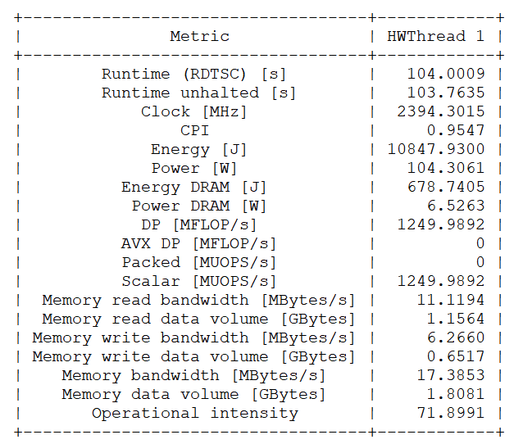
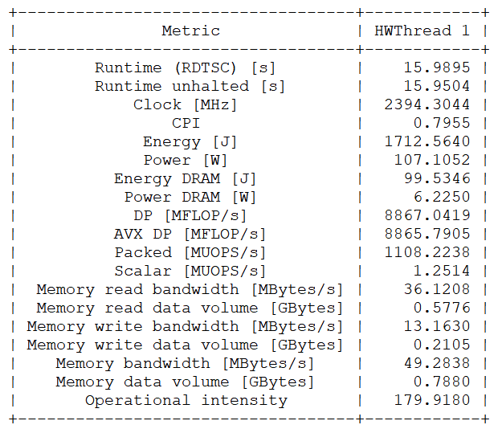
LIKWID counter comparison
1000x1000 Mesh size with 10000 iterations
Normal SOR
RB SOR
-O3 -xHost -qopt-zmm-usage=high

Slide 17
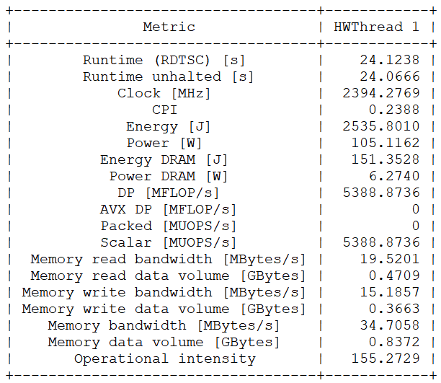
LIKWID counter comparison
1000x1000 Mesh size with 10000 iterations
Normal SOR
RB SOR
-O3 -xHost –fp-model=precise -qopt-zmm-usage=high

Slide 18
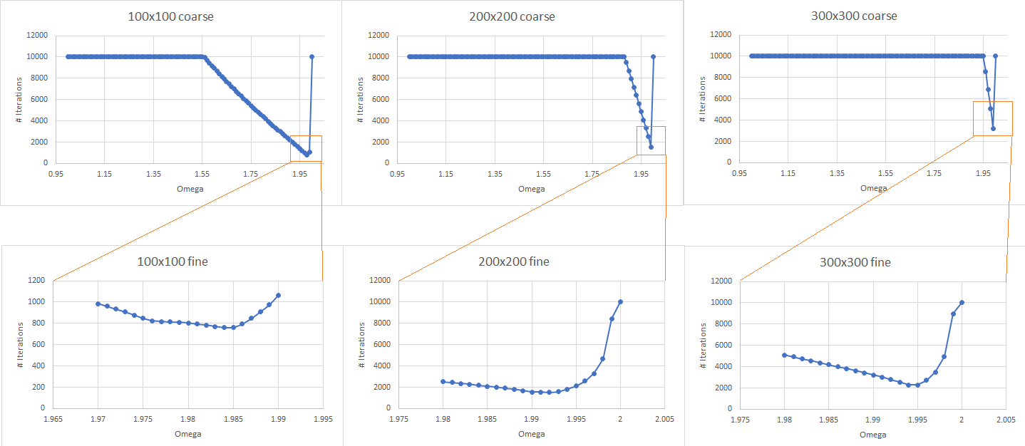
Convergence test and results on 2D Poisson solver

Slide 19
Particle Tracing

Slide 20
Objectives
Basics about Particle Tracing
How to interpolate in 2D
Results from 2D sequential code
Basic idea for 2D MPI
Future work

Slide 21
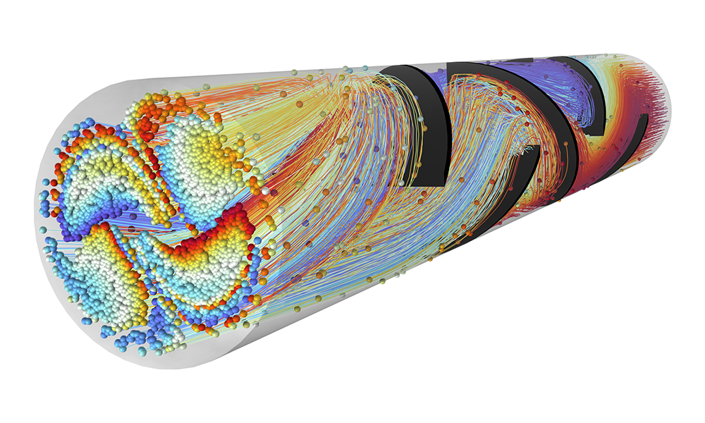
What is Particle Tracing
Ref : https://cdn.comsol.com/product-new/particle-tracing-module/full/particle-tracing-module-hero.png

Slide 22
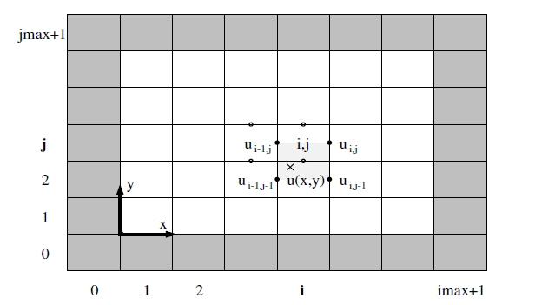

Interpolating using nearest discrete velocity fields
What do we have ?
  x, y positions.
  U and V velocity fields.
What do we need ?
  u(x, y) and v(x, y) to get u and v velocity at x and y.
Compute new x and y using Euler method:
Ref : https://epubs.siam.org/doi/book/10.1137/1.9780898719703

Slide 23
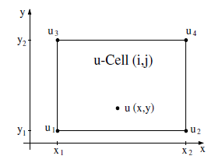
Interpolating using nearest discrete velocity fields
Bilinear Interpolation:
Ref : https://epubs.siam.org/doi/book/10.1137/1.9780898719703

Slide 24
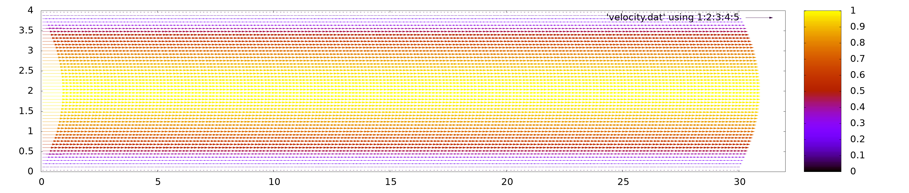

Results - canal

Slide 25
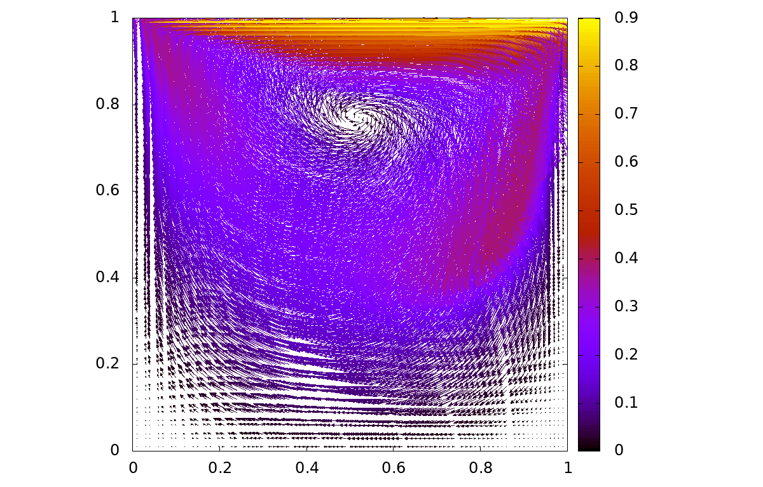
Results - dcavity

Slide 26
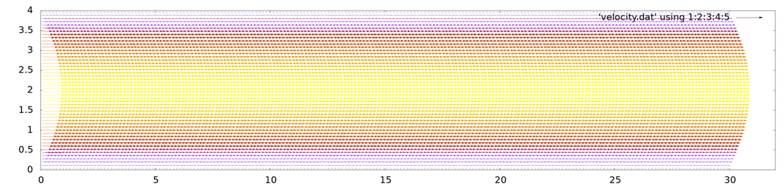
MPI-Implementation
jmaxLocal
Rank 1
jmaxLocal
Rank 3
jmaxLocal
Rank 5
jmaxLocal
Rank 7
imaxLocal
imaxLocal
imaxLocal
imaxLocal
jmaxLocal
Rank 0
jmaxLocal
Rank 2
jmaxLocal
Rank 4
jmaxLocal
Rank 6
imaxLocal
imaxLocal
imaxLocal
imaxLocal

Slide 27
MPI-Implementation
Share xStart, xEnd, yStart & yEnd with each other using MPI_GatherAll()
If particle leaves domain, check in this table to which rank to send.
Communicate number of particles to be sent to other ranks.
If particle leaves domain and belongs to no rank, turn off the particle.
xStart | yStart | xEnd | yEnd
Rank 0
Rank 1
Rank 2
.
.
.

Slide 28
Future Work
Use MPI I/O for writing to the same file rather than sending particles from all ranks to rank 0 and let rank 0 write the particles to single file.

Slide 29
Enhanced Solver

Slide 30
Objectives
What is Enhanced Solver
How Enhanced Solver works
Results – Backward Facing Step
Results – Karman Street Vortexes

Slide 31
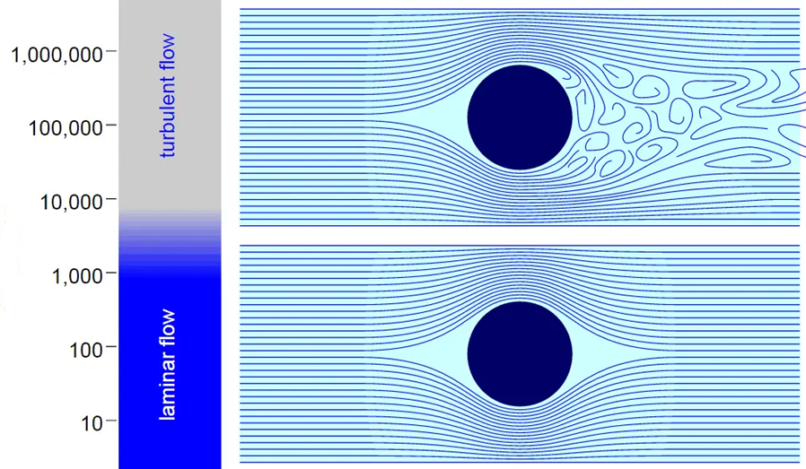
Enhanced Solver
Re

Slide 32
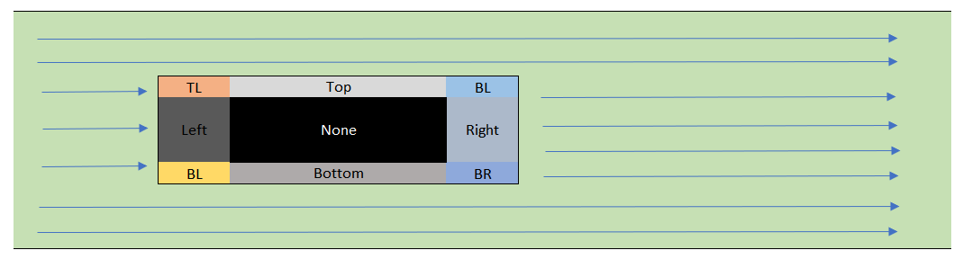
How it works
Determing the shape and assign boundary indexes in the matrix.
Then handle the NO SLIP boundary condition for different boundary index.
We have tried with CIRCLE and RECTANGLE/SQUARE.

Slide 33
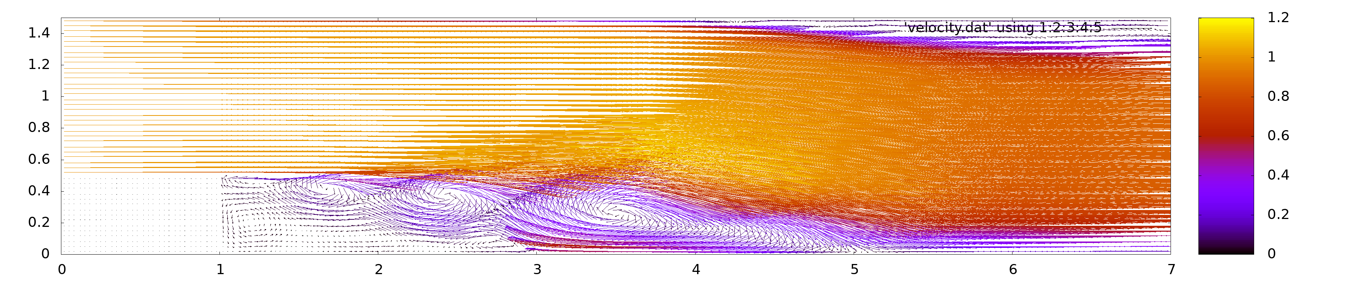

Results – Backward Facing Step with Eddy currents
Re : 5000

Slide 34
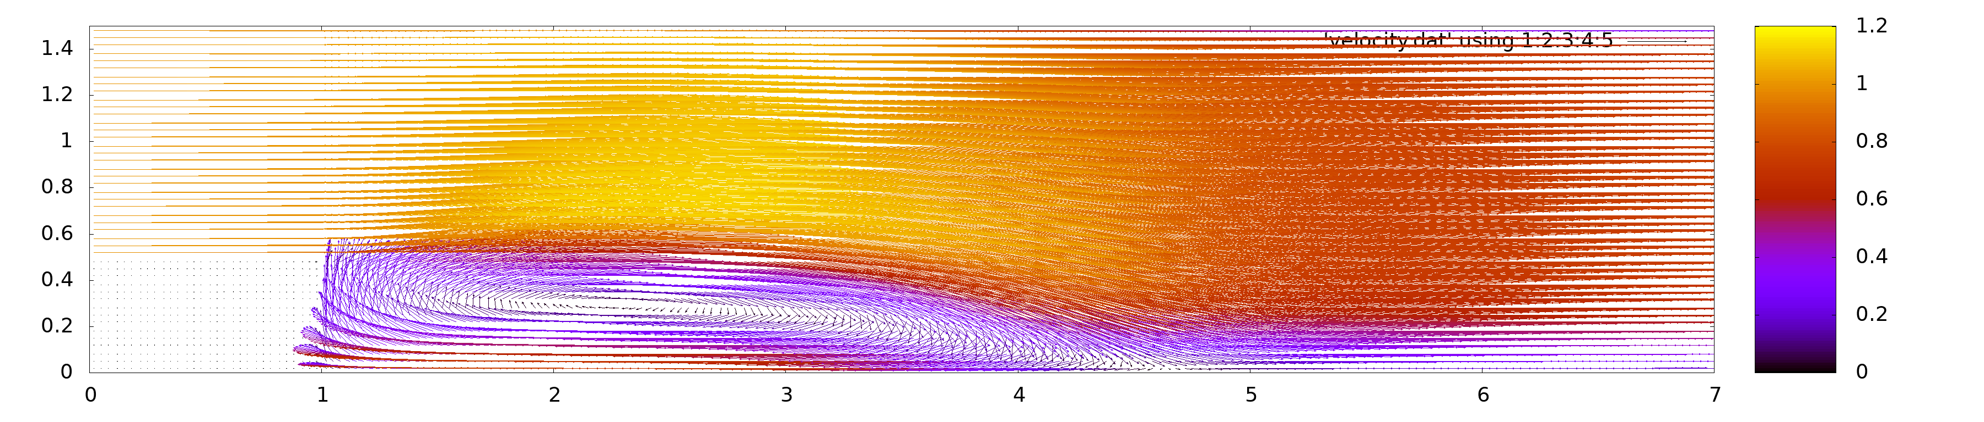
Results – Backward Facing Step with Recirculation zone
Re : 36000

Slide 35
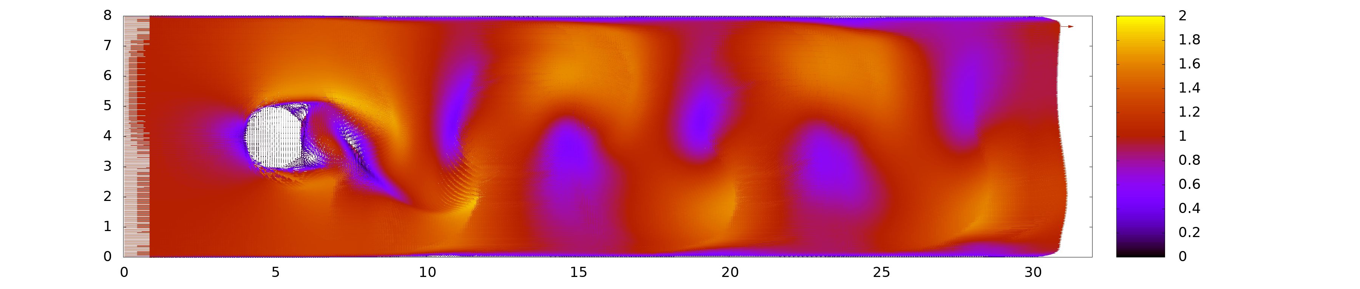

Results – Karman Vortex Street
Re : 5000

Slide 36

Ende.
Danke.

